Slide 1
Entertainer Data Analytics
Domain- Film and Entertainment

Slide 2
Problem Statement
Normal life can be stressful, and people need to relax. Being entertained by others is a wonderful way to take some time out of life. It can reduce stress and make life's issues easier to face. The media and entertainment industry consists of film, television, radio and print. These segments include movies, TV shows, radio shows, news, music, newspapers, magazines, and books.
The entertainment industry is a group of sub-industries devoted to entertainment. The entertainment industry is used to describe the mass media companies that control the distribution and manufacture of mass media entertainment.

Slide 3
General KPIs
Latest Hit Album of Entertainer
Oldest Hit Album of Entertainer
Youngest Entertainer
Oldest Entertainer
First Award Year of Entertainer
Gender Distribution

Slide 4
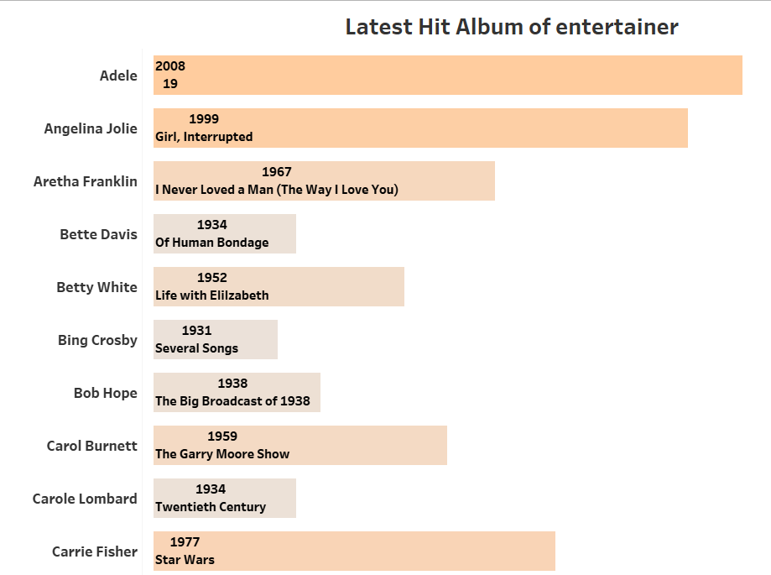

Latest Hit Album of Entertainer
Adele

Slide 5
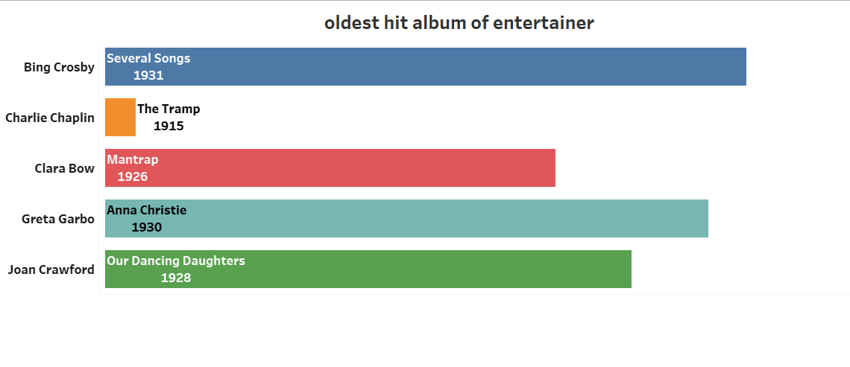

Oldest Hit Album of Entertainer
Charlie Chaplin

Slide 6
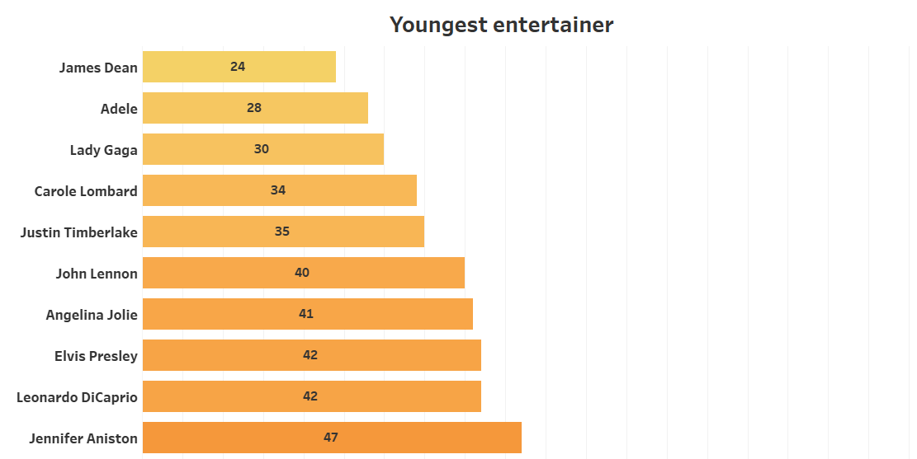

Youngest Entertainer
James Dean

Slide 7
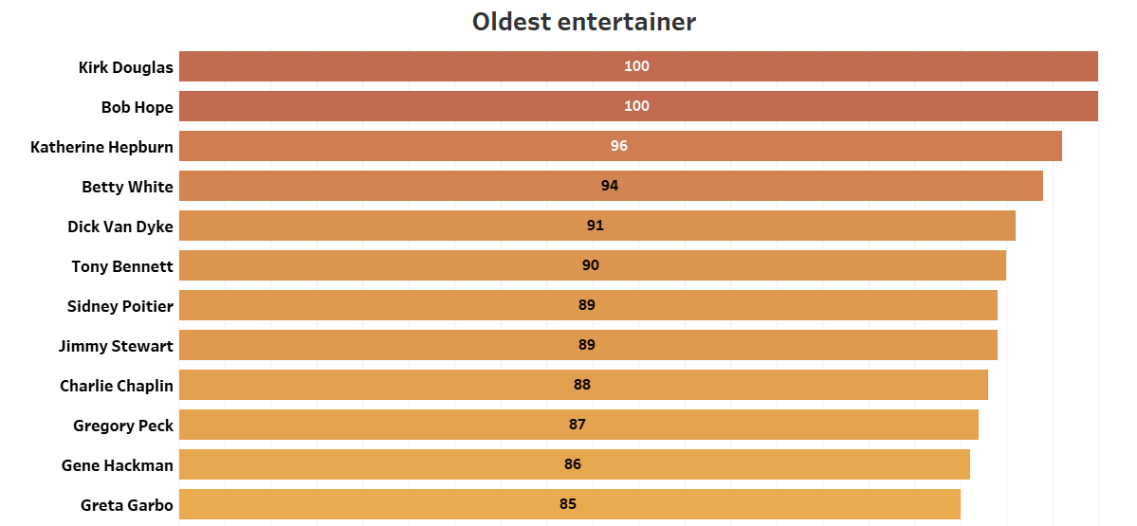

Oldest Entertainer
Kirk Douglas

Slide 8
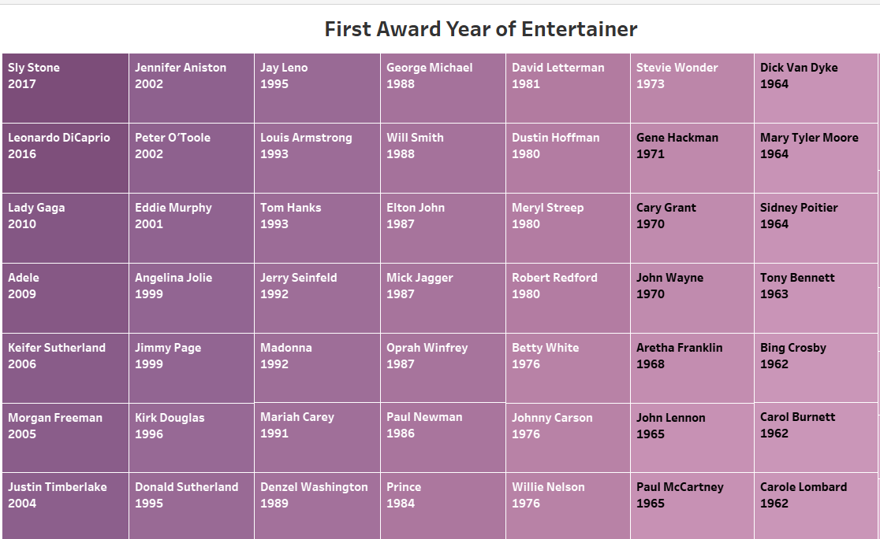
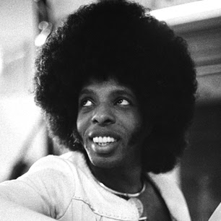
First Award Year of Entertainer
Sly Stone

Slide 9
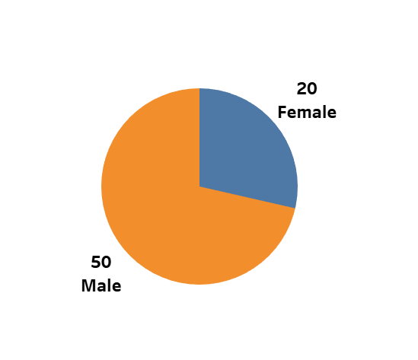

Gender Distribution

